Slide 1
A Case Study of Extract, Transform, Load
Lesson 13.1
Notes:
1.1

Slide 2
Welcome Students
Notes:
1.1

Slide 3

Notes:
1.1
Welcome students and explain that they will be exposed to the Extract, Transform, Load (ETL) process, and solidify their understanding by working on an ETL project.
Explain that they will put to use skills they have learned up to this point, as well as new ones.

Slide 4
The Week Ahead!
Day One (Today)
/ Intro to the ETL process - working through activities
Intro to the ETL Project
/ Goals
/ Requirements
Working towards a feasible project idea with
/ Instructors
/ TAs
Submit Project Proposal
Day Three
/ Project due date - Presentation!
/ Discussion
Day Two
/ Working on projects
/ Full assistance from Instructors and TAs
Notes:
1.1
Brief the class with the week ahead! Set their expectations!
Start off by outlining the requirements of the project.
LEAVE FOR NOW!

Slide 5
Introduction to the Case Study Project
Notes:
1.2

Slide 6
Introduction to the Case Study Project
Data Sources:
It must come from two (minimum) or more sources.
Recommended sources:
Kaggle.
Data.word.
Google Dataset Search (https://datasetsearch.research.google.com/).
As an alternatively source you may use APIs.
Once you datasets are identified - Perform ETL and documentation:
Documentation must have:
Datasets used and their sources.
Types of data wrangling performed - Data cleaning, joining, filtering and aggregating.
The schemata used in the final production database.
Notes:
1.2
Start off by outlining the requirements of the project.
Explain that project must use two or more sources of data.
Two recommended sources are data.world and Kaggle.
Google also has a dataset search interface: https://toolbox.google.com/datasetsearch.
Alternatively, students may use APIs or scrape data from the web. Groups who elect do do this, however, should run it by the instructional staff first.
Explain that once datasets are identified, students will perform ETL on the data, and document the following in a technical report:
Datasets used and their sources
Types of data wrangling performed, such as data cleaning, joining, filtering, and aggregating.
The schemata used in the final production database, whether relational or non-relational.
Finally, assign students to their groups. Each group should have ideally two, no more than three, students. Take individual student strengths as you assign them.

Slide 7
Introduction to ETL
Notes:
1.3

Slide 8

Introduction to ETL
ETL
Data integration is an important part of working with data.
Notes:
1.3

Slide 9





Introduction to ETL
Extract
Data may come from disparate
sources, such as:
CSV files
JSON files
HTML tables
SQL databases
Spreadsheets
Extract
Notes:
1.3

Slide 10
Introduction to ETL
Transform
Transform the data to suit business needs.
This may include:
Data Cleaning
Summarization
Selection
Joining
Filtering
Aggregating
Transform
Notes:
1.3

Slide 11
Note: We will use Python and pandas for transformation, which can also be done with SQL or a specialized ETL tool.
Notes:
1.3

Slide 12
Introduction to ETL
Load
Load the data into a final database that can be used
for future analysis or business use.
Can be a relational or non-relational database
Can be local or in the cloud
Can be a data lake or data warehouse
Load
Notes:
1.3

Slide 13
Notes:
1.3

Slide 14
ETL with Pandas
Notes:
2.1

Slide 15







ETL with Pandas
Not limited to Pandas the ETL process is performed with a variety of tools and file formats.
For this demonstration we will use the following:
Notes:
2.1
Explain that the ETL process can be performed using many of the tools that we have seen, such as postgreSQL (pgAdmin 4) and Pandas.
Before moving into the next slide Go over the 2 datasets we are going to untilize.
First open the following customer_data.csv in Excel and explain along the way:
This data set represents a raw form of input that includes raw customer information.
The only information that is needed for the customer names table are the first three columns.
Next, open customer_data.json in a text editor and explain:
This is another customer dataset with additional information.
This source of data is JSON, but its data is related to the data in the CSV file.
ETL is needed to transform this data into a new database that combines data from both sources.

Slide 16
Couple of things to prepare before we move forward! Let’s find out what it is!
Notes:
2.1

Slide 17
ETL with Pandas
pip install psycopg2
pip install psycopg2
Psycopg is a package -- An adapter for Python that works as a wrapper for libpq, which is the official postgreSQL client library.
Notes:
2.1
Note: Students will need to pip install psycopg2 for the following code examples to work. Slack out instructions for them to do this and show them in the terminal.
Troubleshooting: If you have any issues with installing psycopg2, please refer to the official documentation at http://initd.org/psycopg/docs/install.html.

Slide 18
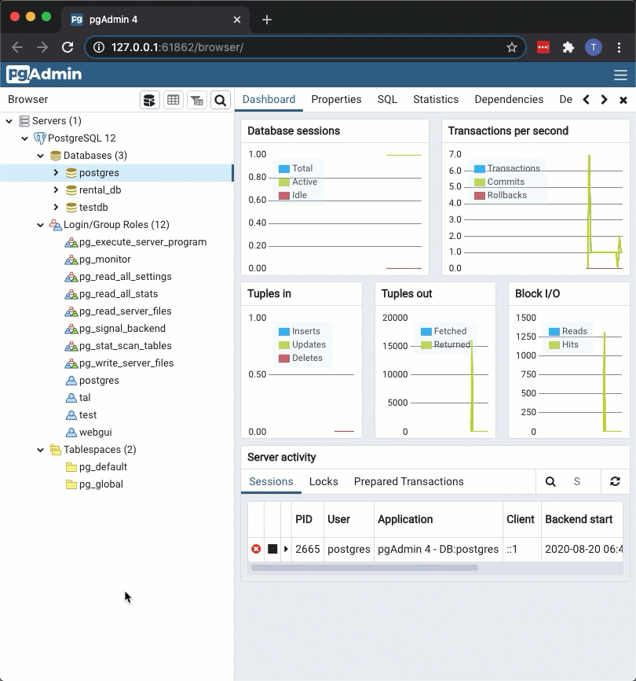

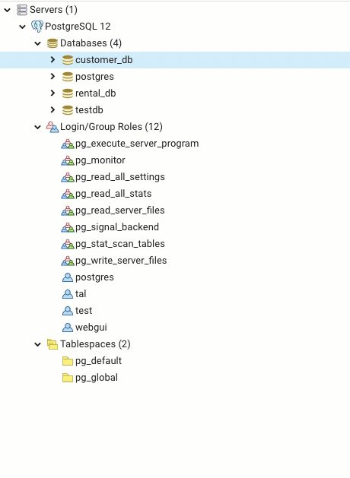
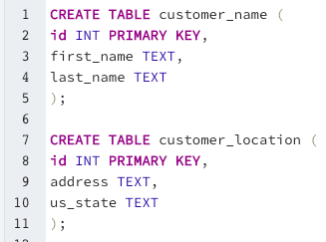

ETL with Pandas
pgAdmin postgreSQL
Second, we need to open pgAdmin 4 and connect to a local server. Once connected we need to create a new database and tables accordingly.
tables
database
Notes:
2.1
Open up pgAdmin 4 and connect to the local server.
Once connected create a new database, customer_db. Then, explain the following steps: <<<<< IMPORTANT TO EXPLAIN SINCE IT’s NOT in the SLIDE >>>>>>
Tables are created ahead of time to ensure that we only load what is needed from the data source. Note the columns will need to have the same names as the DataFrame columns.
Pandas does not allow the assignment of a primary key, so this task needs to be done with pgAdmin 4.

Slide 19
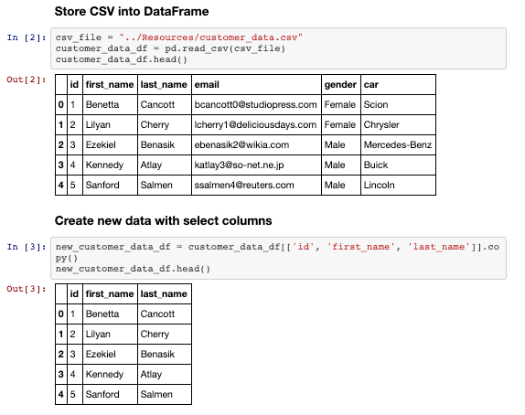
ETL with Pandas
.ipynb (Jupyter Notebook)
Pandas is the pivotal piece of the ETL process. In Pandas, we are going to extract the data, Transform it and load back into dataframes. Let’s follow the code line by line and see how it is done.
Cell #2 has data pulled from a csv file and the data is assigned to a variable called customer_data_df.
Cell #3 is returning a new dataframe with only the necessary columns. The new dataframe is assigned to a new variable as well.
Notes:
2.1
Next open data_etl.ipynb in Jupyter notebook. Go through the code explaining along the way:
Pandas is used in the extraction process to read the CSV into a DataFrame.
Pandas is again used in the transform process to clean the data to take in the columns that are needed for the customer_name table.

Slide 20
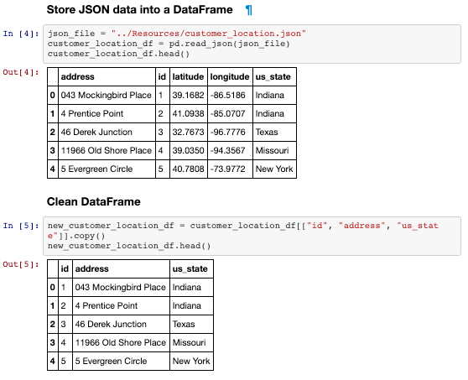
ETL with Pandas
.ipynb (Jupyter Notebook)
The same process of extracting and transforming the data is repeated with the JSON file as well.
Notes:
2.1
This process is repeated using the JSON data and transformed into what the customer_location tables need.

Slide 21
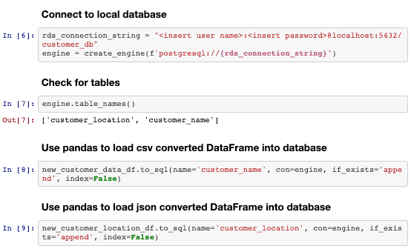
ETL with Pandas
.ipynb (Jupyter Notebook)
The following step is to connect to the local database. Once connected, we check the tables created earlier in the process.
Next, we are dumping the newly created and trimmed dataframes into the database.
Notes:
2.1
Next a library called SQLAlchemy is used to create a connection to the pgAdmin 4 database. Note that SQLAlchemy has expansive features that are beyond the scope of this class right now. Let students know that all they need to know is how to connect to a pgAdmin 4 database.
The connection string consists of user:password@host/db_name. The user will be postgres and the password will be the same one used to connect to pgAdmin 4 server. The host will be localhost:5432. This is then passed into the create_engine function, which starts with postgresql:// followed by the connection string.
Note students may have to pip install psycopg2 package for the connection to pgAdmin 4.
The postgresql:// specifies to SQLALchemy the type of the database connection. This can take other parameters such as mysql and sqlite.
engine.table_names() will confirm a successful connection by returning the names of the tables in the pgAdmin 4 database.
Pandas again will be used in the load process by using the .to_sql() method that takes the name of the table, the connection to the db, what to do if the table already exists and whether to pass an index. Since the table has already been created and exists the DataFrame will append to the current table.

Slide 22
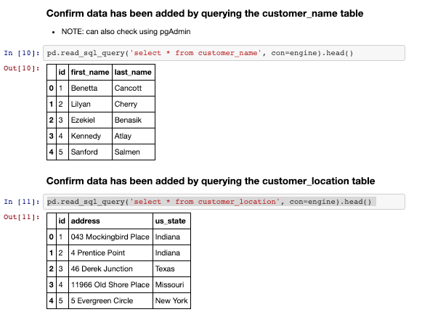
ETL with Pandas
.ipynb (Jupyter Notebook)
At this point, all the data that we extracted and transformed is successfully loaded into our postgreSQL database.
To double check, as a best practice, we performed queries for both tables at the database.
Notes:
2.1
Next, check that the data has been loaded into the database by querying the table in Pandas. Alternatively, the pgAdmin 4 workbench UI can used to also look at the table.

Slide 23
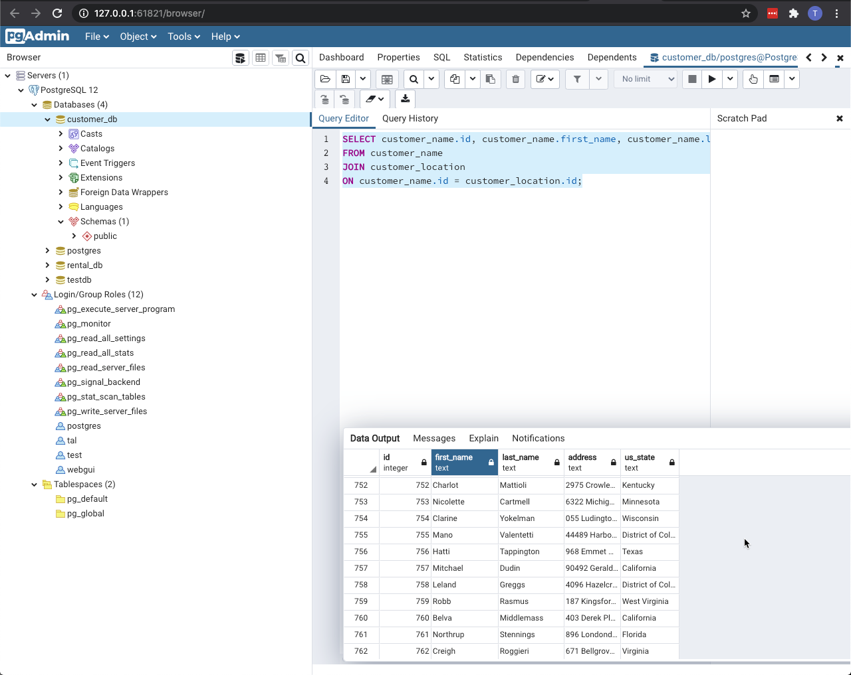
ETL with Pandas
pgAdmin postgreSQL
The last piece of the process is coming back to pgAdmin to perform the join of the two tables we created.
SELECT customer_name.id, customer_name.first_name, customer_name.last_name, customer_location.address, customer_location.us_state
FROM customer_name
JOIN customer_location
ON customer_name.id = customer_location.id;
Notes:
2.1
Next, check that the data has been loaded into the database by querying the table in Pandas. Alternatively, the pgAdmin 4 workbench UI can used to also look at the table.

Slide 24
Activity: Pandas ETL
In this activity, you will have the opportunity to perform your very first ETL process.
20 Minutes
Notes:
2.2

Slide 25
Activity: Pandas ETL
Instructions:
Create a customer_db database in pgAdmin 4 then create the following two tables within:
A premise table that contains the columns id, premise_name and county_id.
A county table that contains the columns id, county_name, license_count and county_id.
Be sure to assign a primary key, as Pandas will not be able to do so.
In Jupyter Notebook perform all ETL.
Extraction
Put each CSV into a pandas DataFrame.
Transform
Copy only the columns needed into a new DataFrame.
Rename columns to fit the tables created in the database.
Handle any duplicates. HINT: some locations have the same name but each license number is unique.
Set index to the previously created primary key.
Notes:
2.2

Slide 26
Activity: Pandas ETL
Instructions:
Load
Create a connection to database.
Check for a successful connection to the database and confirm that the tables have been created.
Append DataFrames to tables. Be sure to use the index set earlier.
Confirm successful Load by querying database.
Join the two tables and select the id and premise_name from the premise table and county_name from the county table.
Notes:
2.2

Slide 27
Notes:
2.3
Open schema.sql in pgAdmin 4 go through the table queries. Explaining:
A tabled called premises is created taking an id as an integer and primary key, a text column for premise_name and another integer column for county_id.
A county table that will take id as an integer and primary key, a text column for the county_name, an integer column for license_count and an integer column for the county_id.
Next, open pandas_etl.ipynb in a Jupyter notebook. Go through the code here explaining along the way:
For the Extraction step, the CSV files are loaded into a Pandas DataFrame.
The Transformation is applied separately to each DataFrame to clean up the data.
Using the premise table created earlier as a guide, a new transform_premise_df DataFrame is created from a copy of the original, taking in the columns License Serial Number, Premises Name, and County ID.
Since the License Serial Number should be unique, this column is used to drop any duplicated data.
Columns are renamed to fit with table names in the database.
Index is set to id, which was declared as the primary key earlier.
This process is mostly repeated for the transform_county_df DataFrame.
The Load process starts by creating a connection to the database.
engine.table_names() is used to check the connection. This step is generally optional and used here to just confirm the connection was successful to the correct database.
Finally, the .to_sql method is used to append each DataFrame to each respective table. Also, note that index=True is used to state that index has been declared in each DataFrame that is being appended.
Open up pgAdmin 4 and using query.sql, query the customer_db database. Quickly explain:
Both tables are queried to verify that the data was correctly inserted into each table.
Now that ETL is complete, the database can be used for further analysis. For example, both tables can be joined if data is needed from both files. This was difficult prior to ETL because the data was stored in different files with duplicate or missing records.

Slide 28


Notes:
-------------------
Image source: AdobeStock_56885471

Slide 29
Activity: Project Proposals
In this activity, you and your fellow group members will be going over the ETL project guidelines.
90 Minutes
Notes:
3.1

Slide 30
Activity: Project Proposals
Team Effort
Due to the short timeline, teamwork will be crucial to the success of this project! Work closely with your team through all phases of the project to ensure that there are no surprises at the end of the week.
Working in a group enables you to tackle more difficult problems than you'd be able to working alone. In other words, working in a group allows you to work smart and dream big. Take advantage of it!
Project Proposal
Before you start writing any code, remember that you only have one week to complete this project. View this project as a typical assignment from work. Imagine a bunch of data came in and you and your team are tasked with migrating it to a production database.
Take advantage of your Instructor and TA support during office hours and class project work time. They are a valuable resource and can help you stay on track.
Notes:
3.1

Slide 31
Activity: Project Proposals
Finding Data
Your project must use 2 or more sources of data. We recommend the following sites to use as sources of data:
Data.world
Kaggle
You can also use APIs or data scraped from the web. However, get approval from your instructor first. Again, there is only a week to complete this!
Notes:
3.1

Slide 32
Activity: Project Proposals
Data Cleanup & Analysis
Once you have identified your datasets, perform ETL on the data. Make sure to plan and document the following:
The sources of data that you will extract from.
The type of transformation needed for this data (cleaning, joining, filtering, aggregating, etc).
The type of final production database to load the data into (relational or non-relational).
The final tables or collections that will be used in the production database.
You will be required to submit a final technical report with the above information and steps required to reproduce your ETL process.
Notes:
3.1

Slide 33
Activity: Project Proposals
Project Report
At the end of the week, your team will submit a Final Report that describes the following:
Extract: your original data sources and how the data was formatted (CSV, JSON, pgAdmin 4, etc).
Transform: what data cleaning or transformation was required.
Load: the final database, tables/collections, and why this was chosen.
Please upload the report to Github and submit a link to Bootcampspot.
Notes:
3.1

Slide 34

“We set sail on this new sea because there is new knowledge to be gained...
We choose to go to the Moon! We choose to go to the Moon…
...not because they are easy, but because they are HARD...”
Parts of President John F. Kennedy
address at the Rice University on the
Nation’s Space Effort delivered on September 12, 1962.
Notes:
3.1
For a little inspiration!
Wish the class good luck and advise them to keep the moral high even in difficult moments!
-------------------
Image source: Shutterstock_520041586

